Slide 1
E SPORTS APPLICATION

Slide 2
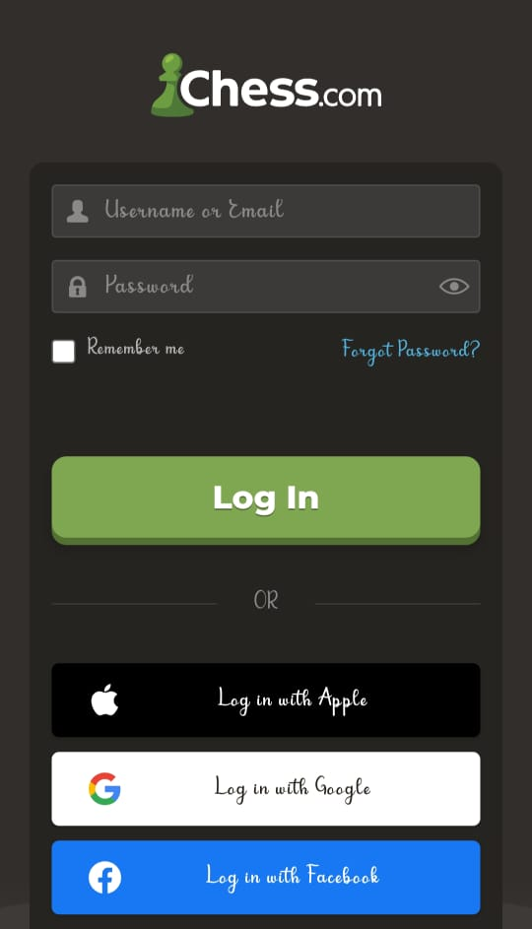
E CHESS PROTAL
WEB APPLICATIONS:

Slide 3
AIM
TO TEST E CHESS PORTAL FUNCTIONALITIES

Slide 4
Requriments:
1. A basic chess set
2. A score sheet.
3. Clothing
4. Abag, once you have got your board,pieces,and clock.

Slide 5
Positive scenario(registration):
* Create user name as per specification
* Create password as per specification
* Confirm password
* Enter mail id
* Send verification code
* Verify mobile otp
* Create account

Slide 6
Negative scenario(registration)
* The user name you provided is not valid
* It must beign with an alphabetical character or number
* The password must be 8 to 64 characters
* The password must have atleast 3 of the following
_an upper case letter
_ an symbol
* Email id must be in smaller letters

Slide 7
Test scenories
* There are even more possible variations of chess games than there are atoms in the observable universe.
*This is the Shannon Number and represents all of the possible move variations in the game of chess.
*The 50 move rule means that if both players make 50 moves without captures or pawn moves then the game is automatically a draw.

Slide 8
Positive scenario (login)
* Enter user name
* Enter password
* Login
* Authorization complete
* Signing in

Slide 9
Negative scenario (login)
* We cant seem to find your account
* The password you entered is incorrect

Slide 10

Thank you

